Slide 1
Ensemble Learning to Improve Machine Learning Results
Presented by
V govinth
Data Specialist

Slide 2
Session Agenda
Introduction to Ensemble techniques
Bagging
Boosting
Stacking
Case Study on Classification problem optimization with ensemble
Case Study on Regression problem optimization with ensemble
How to take forward this into production

Slide 3
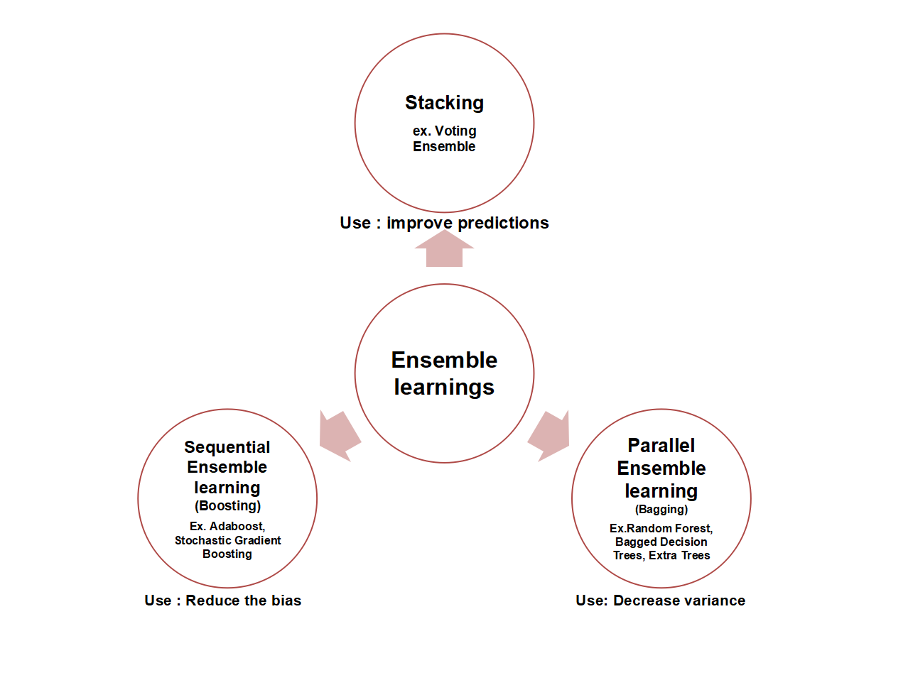
Ensemble methods?
Ensemble methods are meta-algorithms that combine several machine learning techniques into one predictive model in order to decrease variance (bagging), bias (boosting), or improve predictions (stacking).
Types:
Bagging
Boosting
Stacking

Slide 4
Combine Models Into Ensemble Predictions
#Bagging:
Building parallel multiple models (typically of the same type) from different subsamples of the training dataset.
Bagging stands for bootstrap aggregation. One way to reduce the variance of an estimate is to average together multiple estimates.
#Boosting:
Building multiple models (typically of the same type) each of which learns to fix the prediction errors of a prior model in the sequence of models.
#Voting:
Building multiple models (typically of differing types) and simple statistics (like calculating the mean) are used to combine predictions.

Slide 5
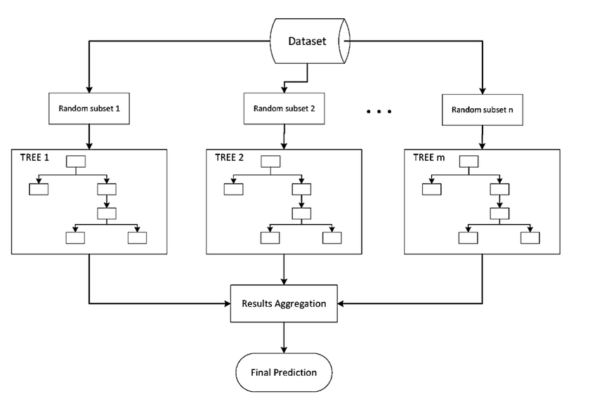
Bagging Ensemble
Building multiple models (typically of the same type) from different subsamples of the training dataset.

Slide 6
Bagging Ensemble Algorithm
Classification | Regression
BaggingClassifier() | BaggingRegressor()
RandomForestClassifier() | RandomForestRegressor()
ExtraTreesClassifier() | ExtraTreesRegressor()

Slide 7
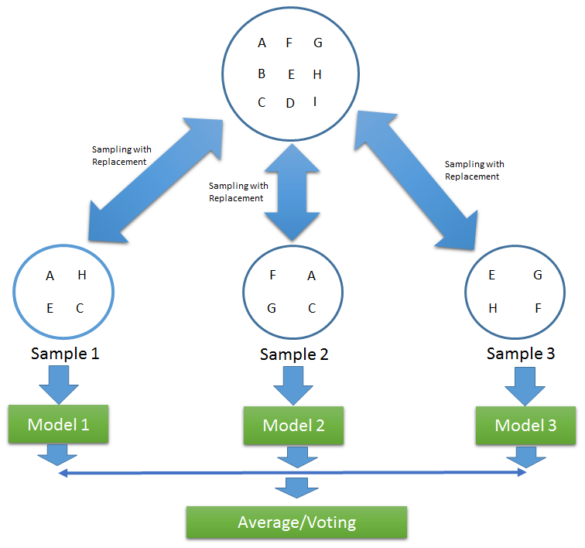
Bagging Working Principles

Slide 8
Random Forest Working Principles
Random Forest is another ensemble machine learning algorithm that follows the bagging technique. It is an extension of the bagging estimator algorithm. The base estimators in random forest are decision trees. Unlike bagging meta estimator, random forest randomly selects a set of features which are used to decide the best split at each node of the decision tree.
Looking at it step-by-step:
Random subsets are created from the original dataset (bootstrapping).
At each node in the decision tree, only a random set of features are considered to decide the best split.
A decision tree model is fitted on each of the subsets.
The final prediction is calculated by averaging the predictions from all decision trees.

Slide 9
Extra Trees Working principles
Extremely Randomized Trees, or Extra Trees for short, is an ensemble machine learning algorithm.
Each Decision Tree in the Extra Trees Forest is constructed from the original training sample.
Then, at each test node, Each tree is provided with a random sample of k features from the feature-set from which each decision tree must select the best feature to split the data based on some mathematical criteria (typically the Gini Index).
This random sample of features leads to the creation of multiple de-correlated decision trees.
The Extra Trees algorithm works by creating a large number of unpruned decision trees from the training dataset

Slide 10
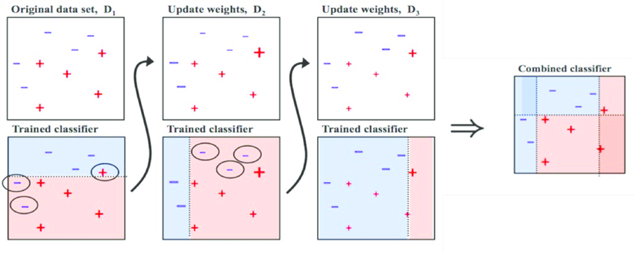
Boosting

Slide 11
Boosting Algorithms
Classification | Regression
AdaBoostClassifier() | AdaBoostRegressor()
GradientBoostingClassifier() | GradientBoostingRegressor()

Slide 12
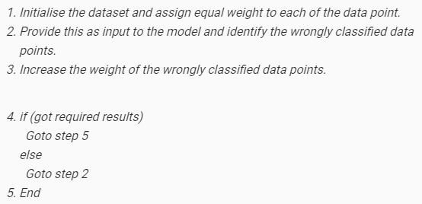
Ada Boost working Principle
AdaBoost is short for Adaptive Boosting and is a very popular boosting technique which combines multiple “weak classifiers” into a single “strong classifier”
Steps:

Slide 13
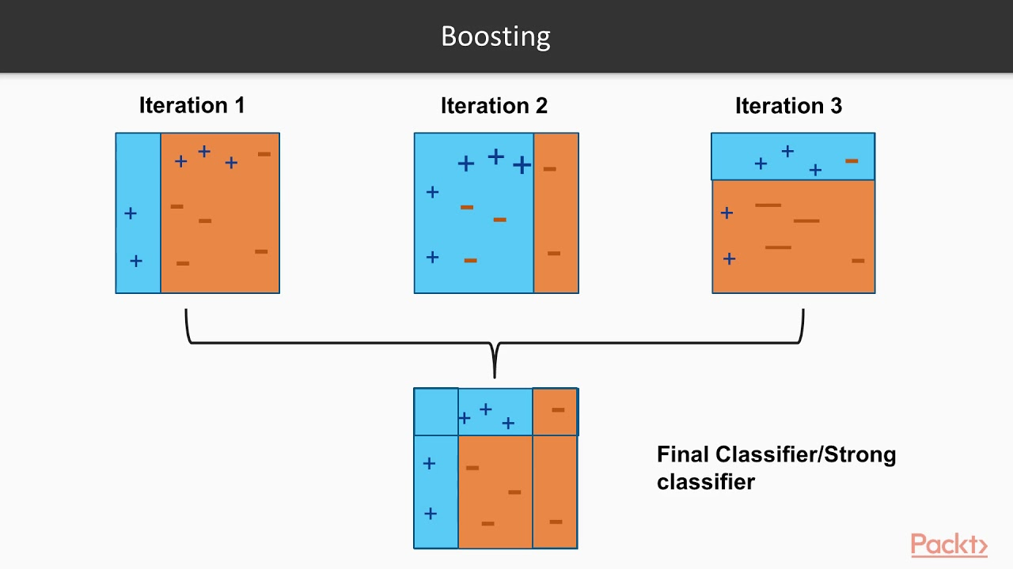
Ada Boost Example

Slide 14
Ada Boost Example Explanation
B1 consist of 10 data points which consist of two types namely plus(+) and minus(-) and 5 of which are plus(+) and other 5 are minus(-) and each one has been assigned equal weight initially. The first model tries to classify the data points and generates a vertical separator line but it wrongly classifies 3 plus(+) as minus(-).
B2 consists of the 10 data points from the previous model in which the 3 wrongly classified plus(+) are weighted more so that the current model tries more to classify these pluses(+) correctly. This model generates a vertical separator line which correctly classifies the previously wrongly classified pluses(+) but in this attempt, it wrongly classifies two minuses(-).
B3 consists of the 10 data points from the previous model in which the 3 wrongly classified minus(-) are weighted more so that the current model tries more to classify these minuses(-) correctly. This model generates a horizontal separator line which correctly classifies the previously wrongly classified minuses(-).
B4 combines together B1, B2 and B3 in order to build a strong prediction model which is much better than any individual model used.

Slide 15

Questions?
.

